Slide 2
NEGOTIATING AN EQUITABLE CROP SHARE AGREEMENT (Material and Nonmaterial Participation)

Slide 3
Legal Aspects and Government Farm Program Requirements
Legal Aspects:
Crop share agreements should be in writing to properly record the terms, conditions and agreements between the landlord and tenant.
Crop-share agreements that exceed one year are required to be in writing under Iowa’s statute of frauds rules. (Iowa Code §622.32(4))
A written lease will help protect either party if the deal goes bad.
A lease must be recorded if it exceeds five years.

Slide 4
Government Farm Program Requirements
A landlord’s and tenant’s eligibility in farm programs may be affected by the type of lease.
Person must be “actively engaged in farming” to be eligible for most farm programs and the one payment limit.
A tenant almost always qualifies through contribution of capital, equipment and personal labor and management.
Landlord may qualify if he or she can prove the contribution is significant and directly related to the potential profits and losses of the operation.

Slide 5
Sample Worksheets Calculations, Forms and Real World Examples
Under a basic equitable crop share, landlord and tenant split the profits from the crop according to the percentage of their respective inputs.
Contribution Approach: First, the parties determine the percentage of their respective contributions, excluding “yield increasing inputs”. Second, the landlord and tenant split the crops, other profits, and “yield increasing inputs” according to their respective contribution percentage.

Slide 6
Desired Share Approach: The parties first agree to a crop share percentage and then adjust their contributions according to the crop-share percentage. The result should be the same no matter which crop share determination is used.

Slide 7
Contributions
Land and Quota/Base Rental Value: value of the land should be based solely on the productivity of the land. Cash rent value of the land or rent to value ratio can be used. A rent-to-value ratio is figured by multiplying the land value by an opportunity interest rate (e.g. cash rent/market value).

Slide 8
Irrigation Facilities, Buildings and Grain Storage
Should be valued independently of each other.
Irrigation facilities: valued similar to machinery and equipment taking into consideration the annual depreciation, interest, repairs, taxes and insurance.
Buildings: valued by the depreciation, interest, repairs, taxes and insurance on the building. Or, a fair market rental value can be used.
Grain Storage: valued as other buildings through the cost of depreciation, interest, repairs, taxes and insurance. Or the rate of the cost of grain storage at the local elevator.

Slide 9
Depreciation/Interest and Operating Costs
Machinery and equipment value is based on an average value of current machinery and equipment rather than new value.
The value of machinery and equipment includes the depreciation, taxes, insurance and interest.

Slide 10
Labor and Management
A landlord looking to ensure “material participation” in the operation may want to take on some of the labor and management duties.
Labor can be valued at the going wage of farm employees in the community.
Management is valued separately and can be based on a percentage of the average capital managed (1 to 2.5%) or the rate of a professional farm manager (5 to 10% of adjusted gross receipts)

Slide 11
Fertilizer Costs, Application and Carryover Value
Fertilizer costs: valued at the actual cost of the fertilizer plus of the cost of application. The tenant should be compensated for any value left over from the fertilizer which will carry over into the years after the lease terminates.
Herbicide and Insecticide Costs: Pesticides costs are valued at the cost of the pesticide plus the cost of application.
Important note: Fertilizer, pesticides and irrigation practices are considered “yield increasing inputs”.

Slide 12
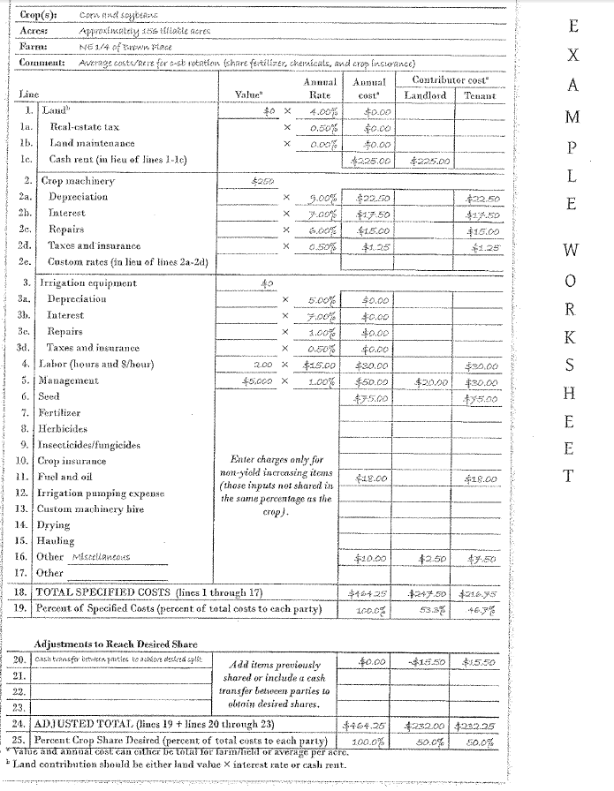

Slide 13
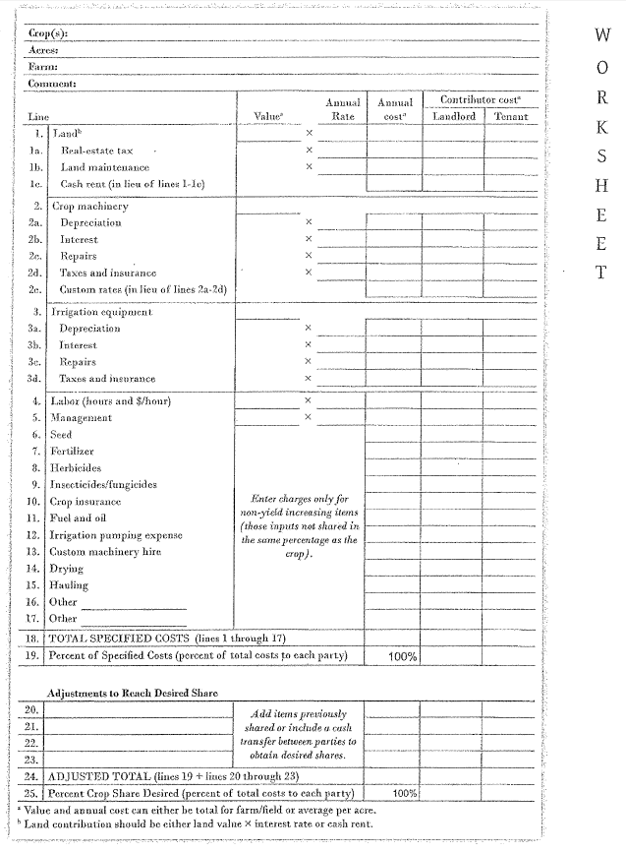

Slide 14
TAX ASPECT TO CONSIDER
Self Employment and Social Security
Generally rental income from a crop share agreement is not considered self employment income unless the landlord materially participates in the farming operation.
A material participation lease (1) provides for material participation in the production or management of the operation and (2) the landlord actually materially participates in the operation.

Slide 15
Tax Deductions
Landlords may exclude crop share rental income if the landlord meets the requirements of specific USDA cost sharing programs.
Soil and water conservation and fertilizer and lime expenses may be deductible.
Business interest incurred in a farming operation is deductible if the landlord materially participates in the farming operation.

Slide 16
Additional Tax Incentives
Beginning Farmer Tax Credit program allows landlords to earn tax credits for leasing their land to beginning farmers.
Maximum credit is $50,000 and includes a 17% tax credit if the lease duration is between two to five years.
Tenant must be over 18 years old and have a net worth less than $343,000.

Slide 17
Tenant/Landowner share ratio
Most common are 50/50, 60/40 and 2/3-1/2 ratios.
Equitable share ratio should mirror the ratio of each party’s inputs.

Slide 18
Splitting Crop and Government Payments
Crop and government payments are split in the same ratio.
All terms are negotiable.
One party may desire to take a larger percentage of the government payment where the government payment is stable and the crop profit is more variable.

Slide 19
Key Clauses to Negotiate
Good husbandry
Landlord should ensure the lease includes a provision requiring the tenant farm in a good and husbandlike manner.
Allows the landlord to enter the land and care for the crops appropriately in the event the tenant fails to do so.
Environmental Clause
The landlord confirms the property does not have any environmental concerns while the tenant agrees to follow any and all environmental laws.

Slide 20
Indemnification clause
Lease should specify who is responsible for accident which occur on the farm and the party responsible will indemnify the other.
Clause should also provide who is responsible for maintaining insurance.
Responsibility for building maintenance
Tenant should request a provision requiring reimbursement if the tenant incurs cost in maintaining and improving buildings.

Slide 21
Removal of personal property
Parties should agree on a time frame for the tenant to remove all personal property.
Permanent improvement
Generally a tenant is not entitled to compensation of permanent improvements.
Tenant is also not entitled to remove the permanent improvement.

Slide 22
Above ground plants
Iowa law provides the tenant is entitled to any part of the above ground plant associated with the crop.
Contractual lien
Landlord can obtain a statutory lien against all crop grown on the leased property plus the tenant’s non-exempt personal property used or kept on the leased property.
Landlord may want to extend his/her statutory lien beyond the crops grown on the leased land and attach to the tenant’s exempt property.

Slide 23
Changes to lease in writing
Amendment should be in writing to ensure the parties adequately understand and approve of the changes.

Slide 24
Conclusion

